Slide 1


For Beginner
By :- RAHUL JOGRANA
www.dotnetlab.in
www.aspnetinhindi.blogspot.com
Twitter:- @thejograna
Github:- github.com/rahuljograna
Part 14 action Sheet controller in ionic

Slide 2

ActionSheet in ionic
Action Sheets slide up from the bottom edge of the device screen, and display a set of options with the ability to confirm or cancel an action. Action Sheets can sometimes be used as an alternative to menus, however, they should not be used for navigation.
The Action Sheet always appears above any other components on the page, and must be dismissed in order to interact with the underlying content. When it is triggered, the rest of the page darkens to give more focus to the Action Sheet options.

Slide 3
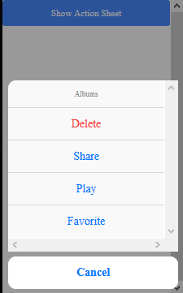
Actionsheet in ionic

Slide 4
Let’s start

Slide 5
To learn new Technology along with Example like
ASP.NET, ASP.NET MVC, AngularJS, ASP.NET Web API
From Beginners visit my Youtube channel and steps and Source code is
Available on My Blog and Web site
To Get notification for new updates Subscribe my YOUTUBE Channel.
Source Code :- http://aspnetinhindi.blogspot.com
Website :- http://www.dotnetlab.in
Github :- https://github.com/rahuljograna
Twitter :- twitter.com/thejograna
Mail :- rahuljograna007@gmail.com
WhatsApp Number :- 9426585554

Slide 6
To Develop Application
Contact me
Mail me : rahuljograna007@gmail.com
Mobile : +91 9426585554
whatsApp : +91 9426585554

